Slide 1
HOGMANY MOTHERS’ DAY ROBERT BURNS’ NIGHT SHROVETIDE VICTORY DAY SWAN UPPING MASLENNITSA THANKSGIVING DAY GUY FAWKES’ NIGHT
What do these words refer to?

Slide 2
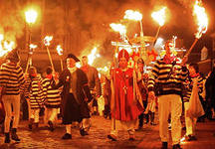
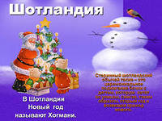
What country do these holidays refer to?

Slide 3
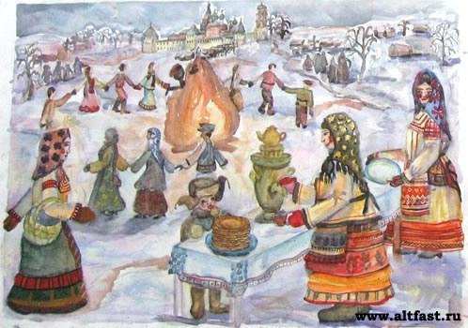
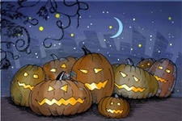
What country do these holidays refer to?

Slide 4
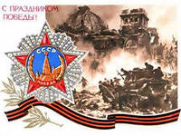
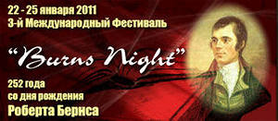
What country do these holidays refer to?

Slide 5
TOPIC : HOLIDAYS IN ENGLAND, SCOTLAND, RUSSIA
Stages of the lesson:
Remember some facts about holidays
Read the texts
Retell (summarize) texts
Find some new information
Discuss similarities and differences

Slide 6
Holiday: Country:
I KNOW
(before reading)
I HAVE KNOWN
( after reading )
ACTIVITIES

Slide 7
Holiday: Country:
Activities:

